Slide 1
Introduction to Python
ZeeShan Ali Shoban
Co-Founder /Chief Instructor :D explore X

Slide 2
Table of Content
Why to Learn Python Now?
Top 10 reason to learn this course?
Python Introduction
Major/Popular Apps in Python
More about Python
Features
Learning Path

Slide 3
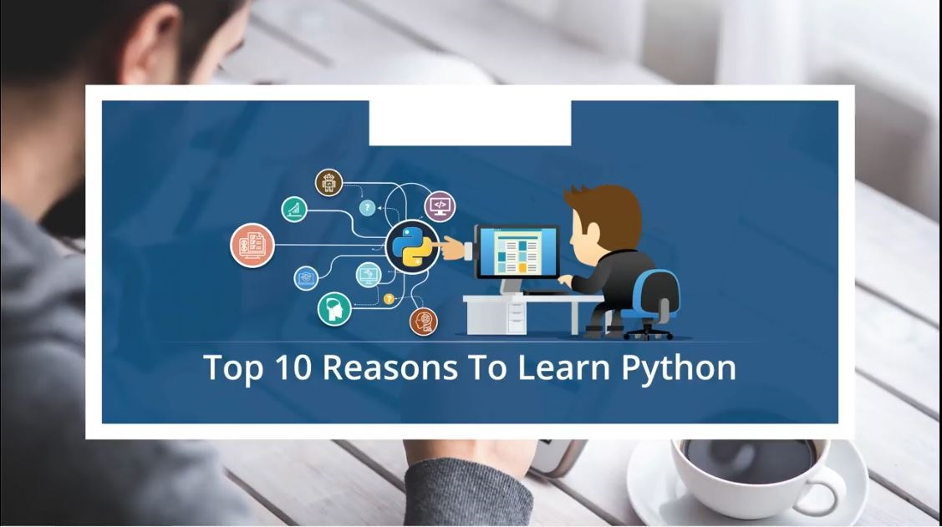

Slide 4
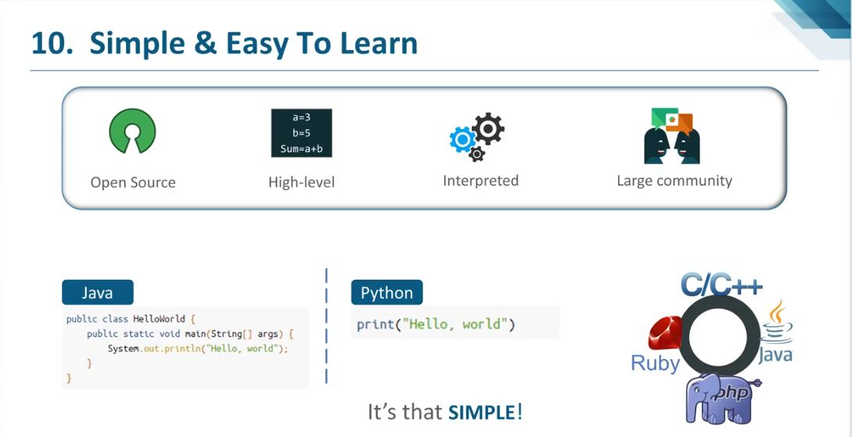

Slide 5
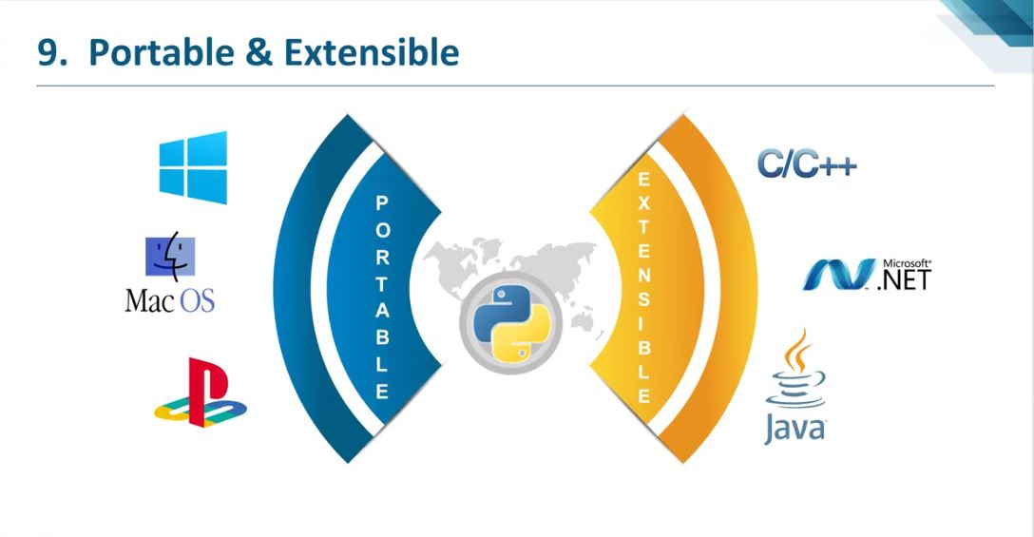

Slide 6
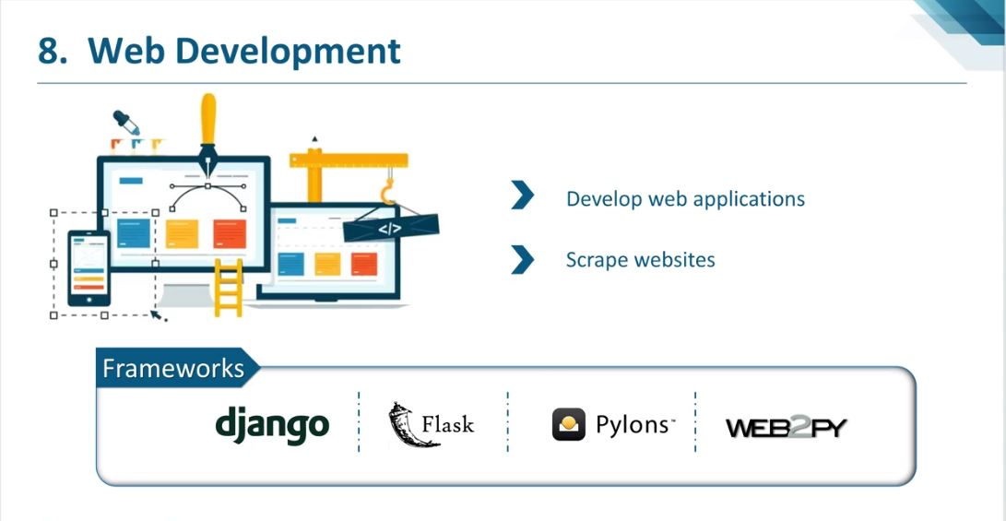

Slide 7
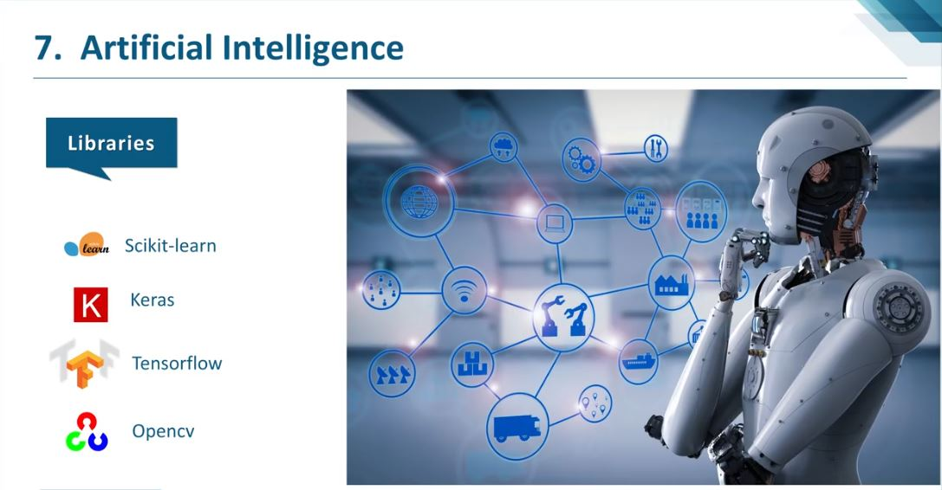

Slide 8
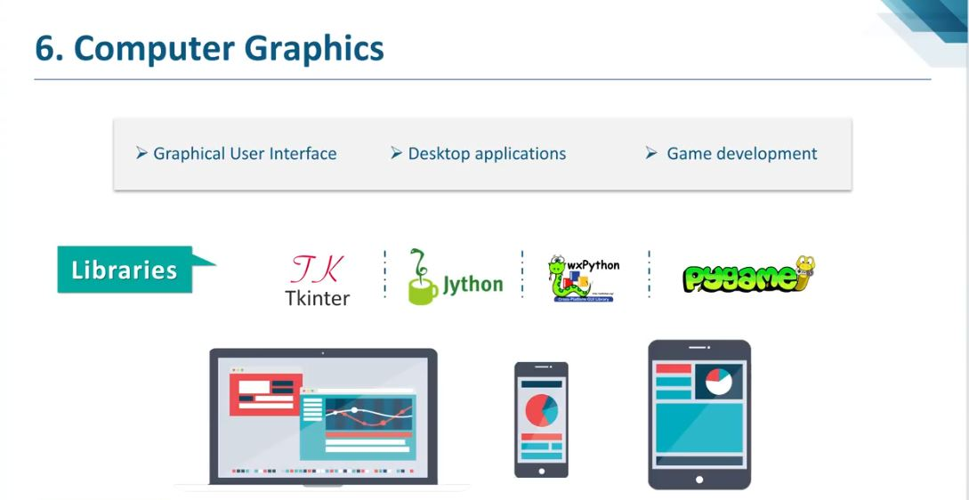

Slide 9
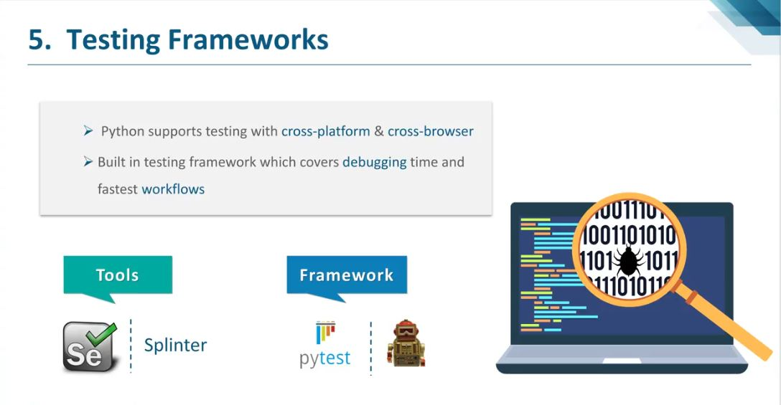

Slide 10
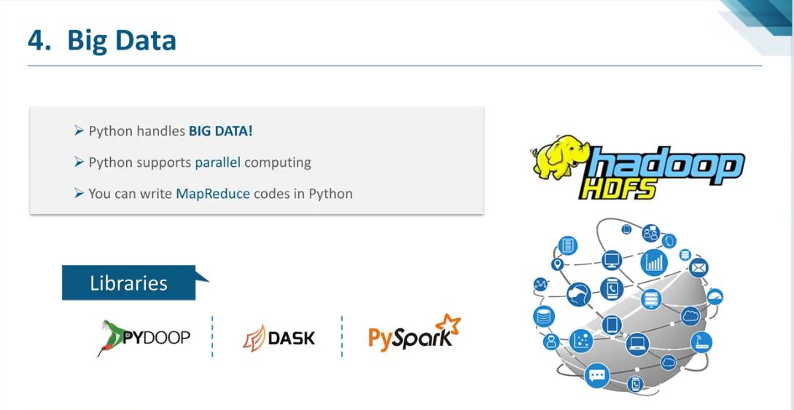

Slide 11
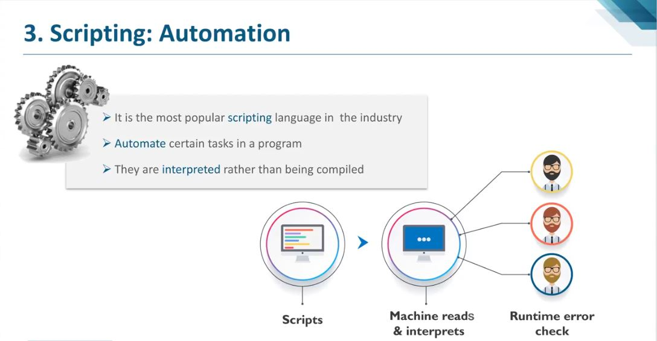

Slide 12
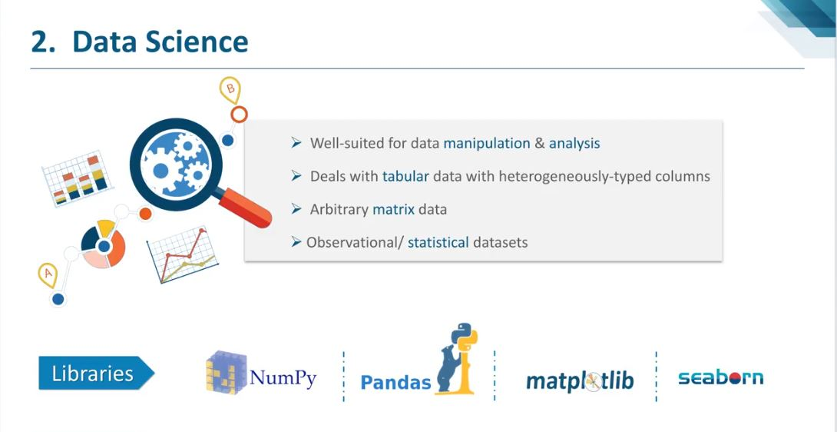

Slide 13


Slide 14
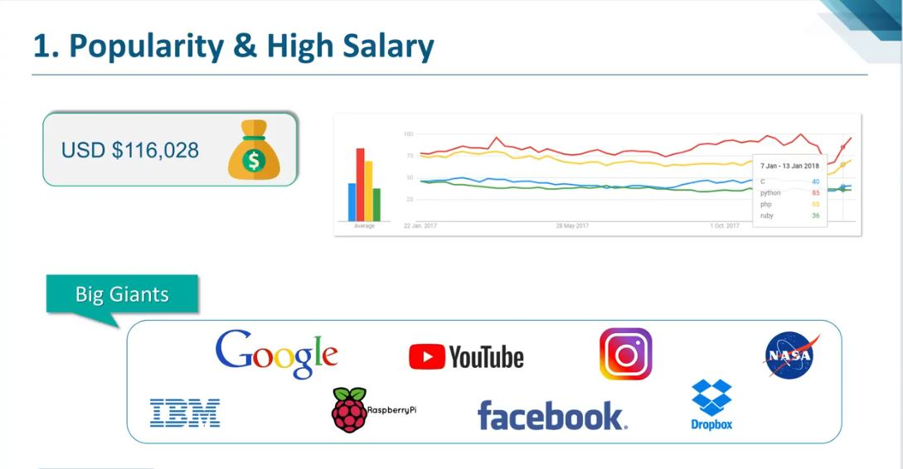

Slide 15
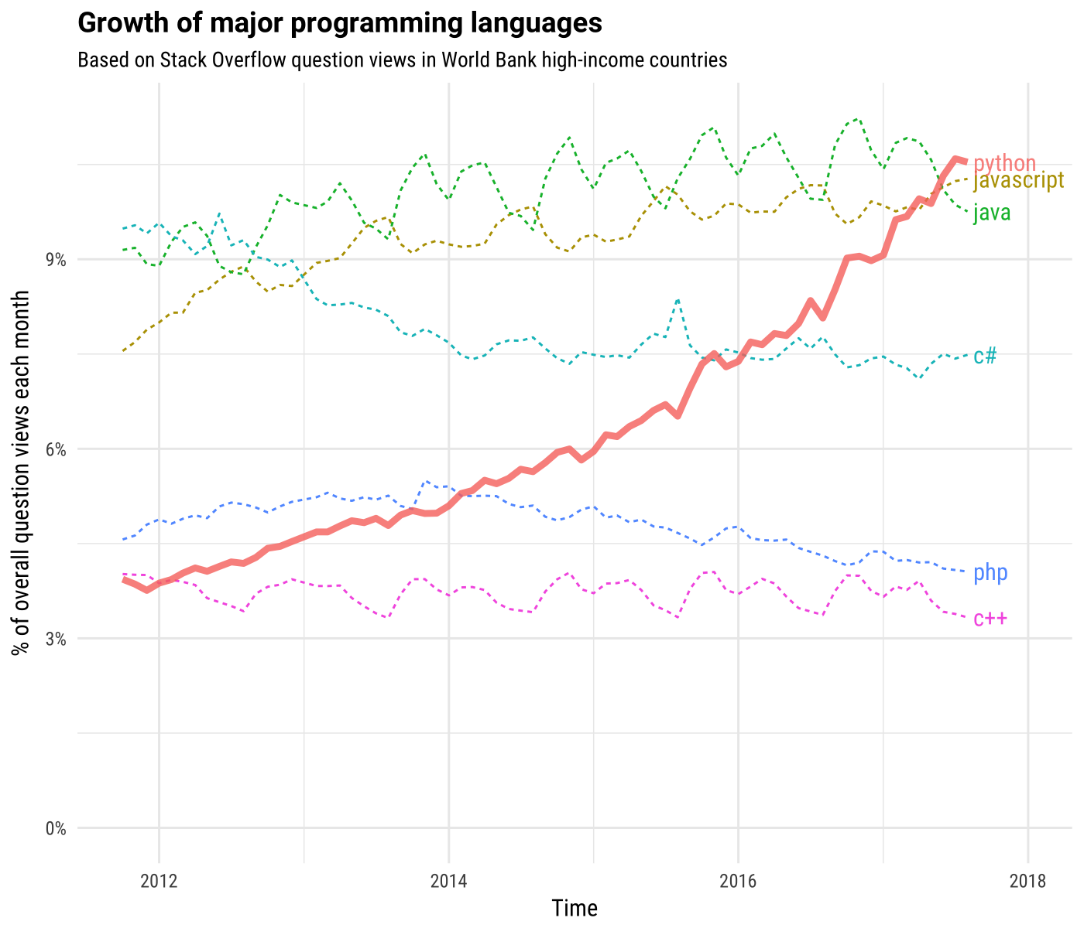
Why I’m Learning Python in 2021

Slide 16
Who can learn this course?
For beginners
For students
For teachers
For professionals who want to polish their skills and move towards python
For all those who want to learn programming

Slide 17
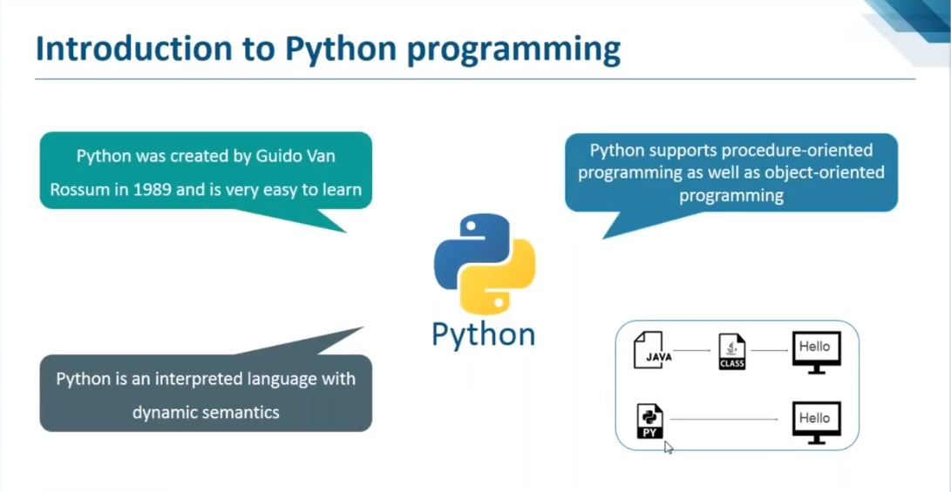
Notes:
Python is a general purpose cross-platform high level programming language, meaning, it runs on multiple platforms like Windows, Mac OS X, Linux, Unix and has even been ported to the Java and .NET virtual machines. It is free and open source. Created by Guido van Rossum and first released in 1991.
Typing discipline: Duck, dynamic, strong since version 3.5: Gradual
Designed by: Guido van Rossum
Stable release: 3.7.0 / 27 June 2018; 2 months ago; 2.7.15 / 1 May 2018; 4 months ago
Paradigm: Object-oriented, imperative, functional, procedural, reflective
Filename extensions: .py,.pyc,.pyd,.pyo (prior to 3.5),.pyw,.pyz (since 3.5)
Parent company: Python Software Foundation

Slide 18
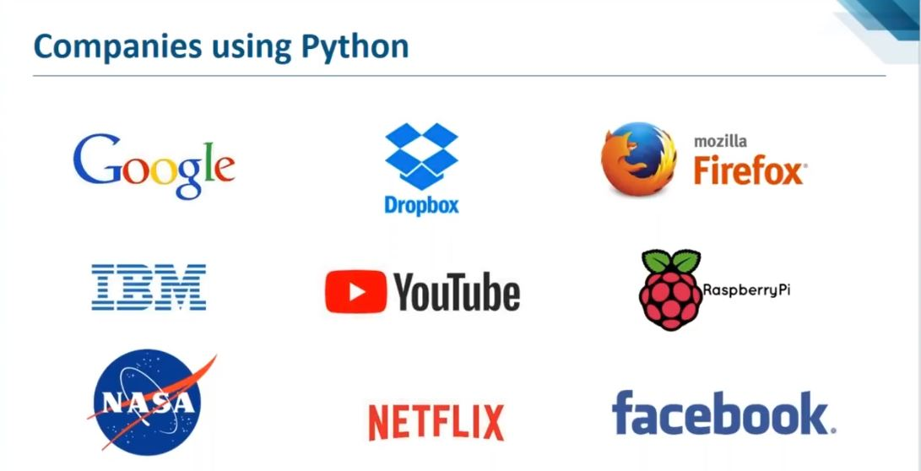
Notes:
Python is a popular programming language.
It is used for Console App, web development (server-side), software development, mathematics, system scripting, Mobile Application, Internet of Things (IoT), Machine Learning and Data Science
Popular Applications developed in Python
YouTube Google Instagram
Mozilla Firefox Quora Bit torrent
Dropbox

Slide 19
More about Python
Python works on different platforms (Windows, Mac, Linux, Raspberry Pi, etc).
Python has a simple syntax similar to the English language.
Python has syntax that allows developers to write programs with fewer lines than some other programming languages.
Python runs on an interpreter system, meaning that code can be executed as soon as it is written. This means that prototyping can be very quick.
Python can be treated in a procedural way, an object-orientated way or a functional way.
Case Sensitive language, meaning A and a are different things.
Dynamically typed, no need to declare variables first.
Indentation is used in place of curly braces.

Slide 20
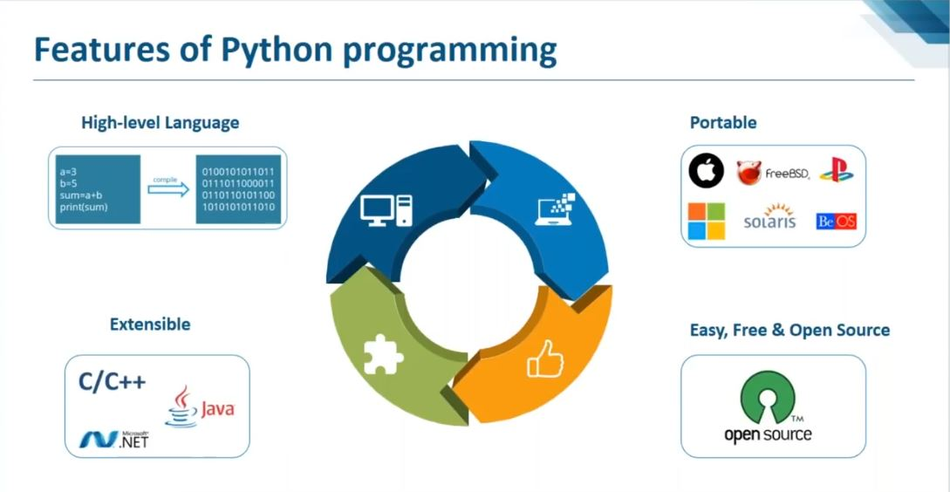
Notes:
Emphasis on code readability
Automatic memory management
Dynamically typed
Large library
Multi-Paradigm programming language (object oriented, procedural etc)
Platform Independent
Interactive Interpreter to check python commands

Slide 21
Learning Path
Python Basics
GUI App with python
Python for Data Science
Big Data Analytics
Web App with python
Python for AI & Machine Learning
Python for IOT

Slide 22
Course Outline
Intro to Python
Displaying text
Storing numbers + input from user
Control Structure
Complex decision with code
Looping Structure + Loops
Functions
Handling errors
File Handling
Lists + tuple
Sets + Dictionaries
Functions

Slide 23
